Slide 1
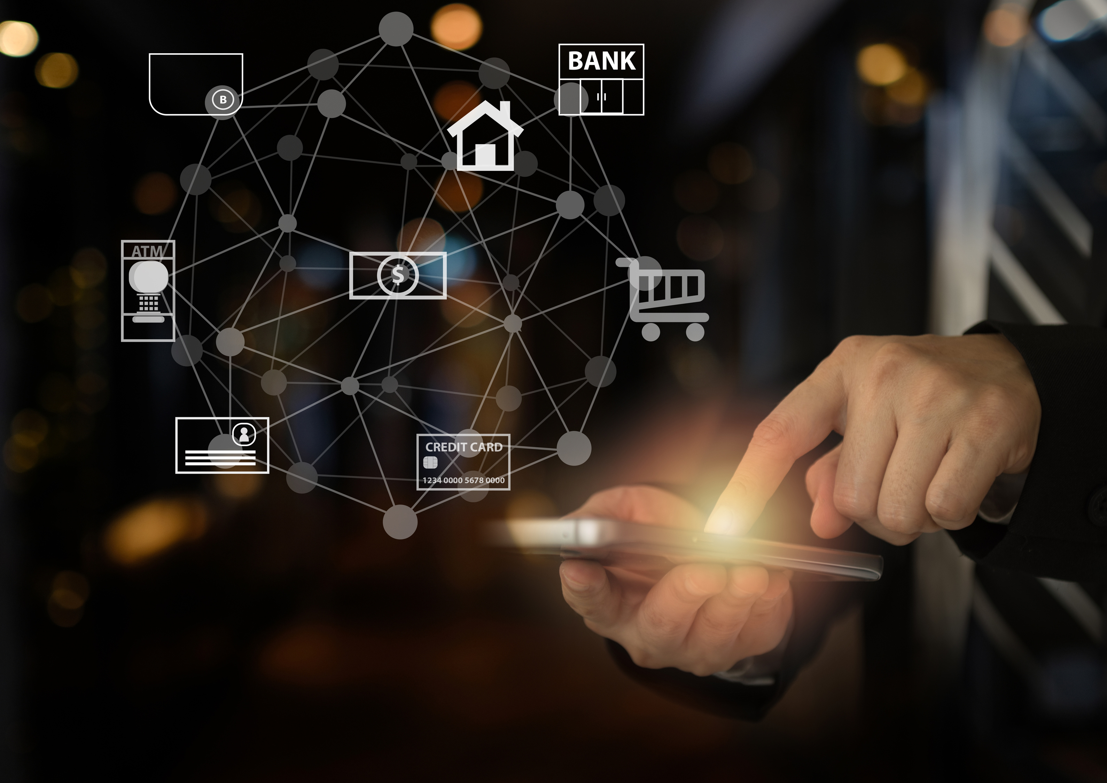

The Future of Identity
Unassailable Endpoint Identity
5+ Factors – Universal - Future-Proof
7 Patents Granted
10+ Patents Pending
4 Registered Trademarks
March 2025

Slide 2
WHO is Really at the Endpoint?
Eliminating these Threats
80% of Cybercrimes Start with Stolen Credentials (Breaches, Ransomware Attacks, and Identity Theft)
Mobile Biometrics at Time of Identity Verification
Fake Callers
(Social Engineering &.AI Deepfakes)
On-Demand, Real-Time Identity During a Call
Same Mobile App
5+ Factors of Identity in 1-Click
Confidential ©2025 iVALT®

Slide 3






Mobile-Centric Identity
Stops BOTH Stolen Credentials and Fake Callers
Mobile App Notification → 1-Click Response
Geofencing
Unique User
Dynamic Variables
Biometrics
Device ID
Unique Code
GPS
Time
IDENTITY
+
DYNAMIC CONTEXT
Zero Trust
Enterprise IAM
Backward Compatible
Future-Proof
On-Demand Caller Identity
Helpdesks (and E2E IDs)
Customer Service (2-way IDs)
Any Application or Use Case
Confidential ©2025 iVALT®

Slide 4
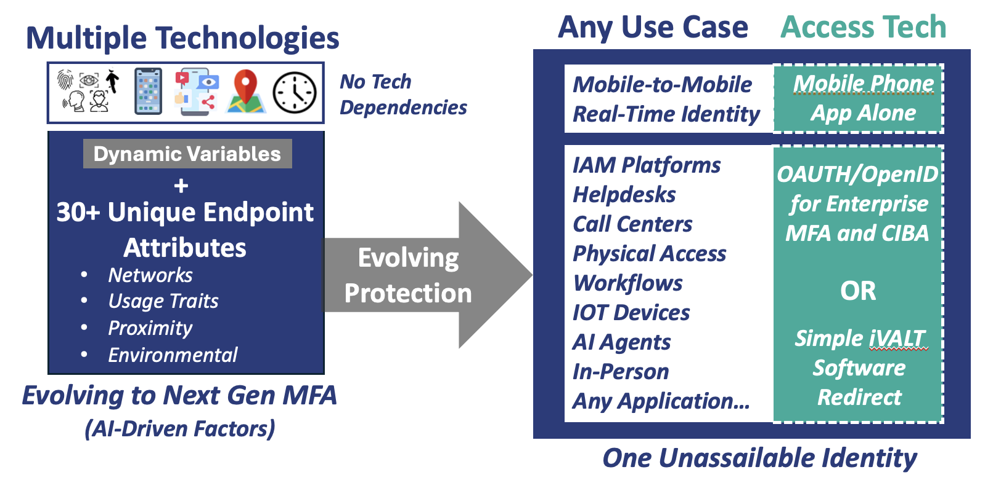
Futureproof
Constantly Evolving with New Technology and New Available Factors
Confidential ©2025 iVALT®

Slide 5


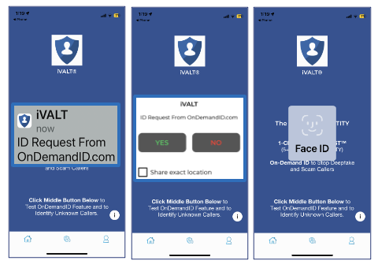

1-Click User Experience
3-5+ Factor Authentication
On-Demand ID™
ANY IDENTITY REQUEST
Stops Stolen Credentials
3FA = Our 2FA + Biometrics
Push Notifications
Driven by Registered
Mobile #
Real-Time Identity
1-Click Response
✓
Same UX for Everything
Stops Social Engineering and AI Deepfakes
Same Auth Engine
One Mobile App
Any Application or Use Case
iVALT is the Only Reliable Mobile User Identity Solution
Confidential ©2025 iVALT®

Slide 6
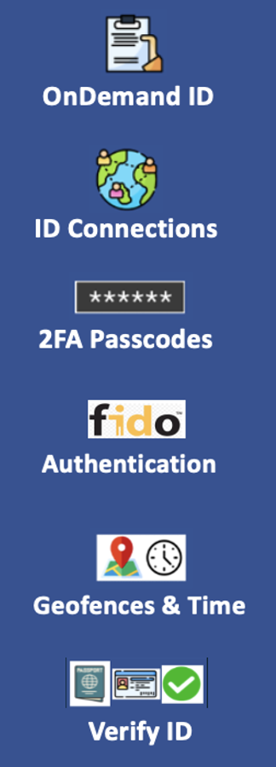
One Identity, One Authenticator
Authenticate Anywhere®
Features
(2025 Roadmap*)
5+ Factors of Identity
Enterprise IAM
OAUTH/OpenID for
MFA and CIBA**
3FA Authentication
2FA with Biometrics
Move to 1-Click Biometrics
Any Application or Use Case
Software Redirect
FIDO2 “Passwordless”
1-Click Passkey Release
*
*
ID Proofing
Digital Driver’s Licenses, Govt Docs
User Set Geofencing and Approved
Time Windows
*
** CIBA = Client-Initiated Backchannel Authentication
Confidential ©2025 iVALT®

Slide 7
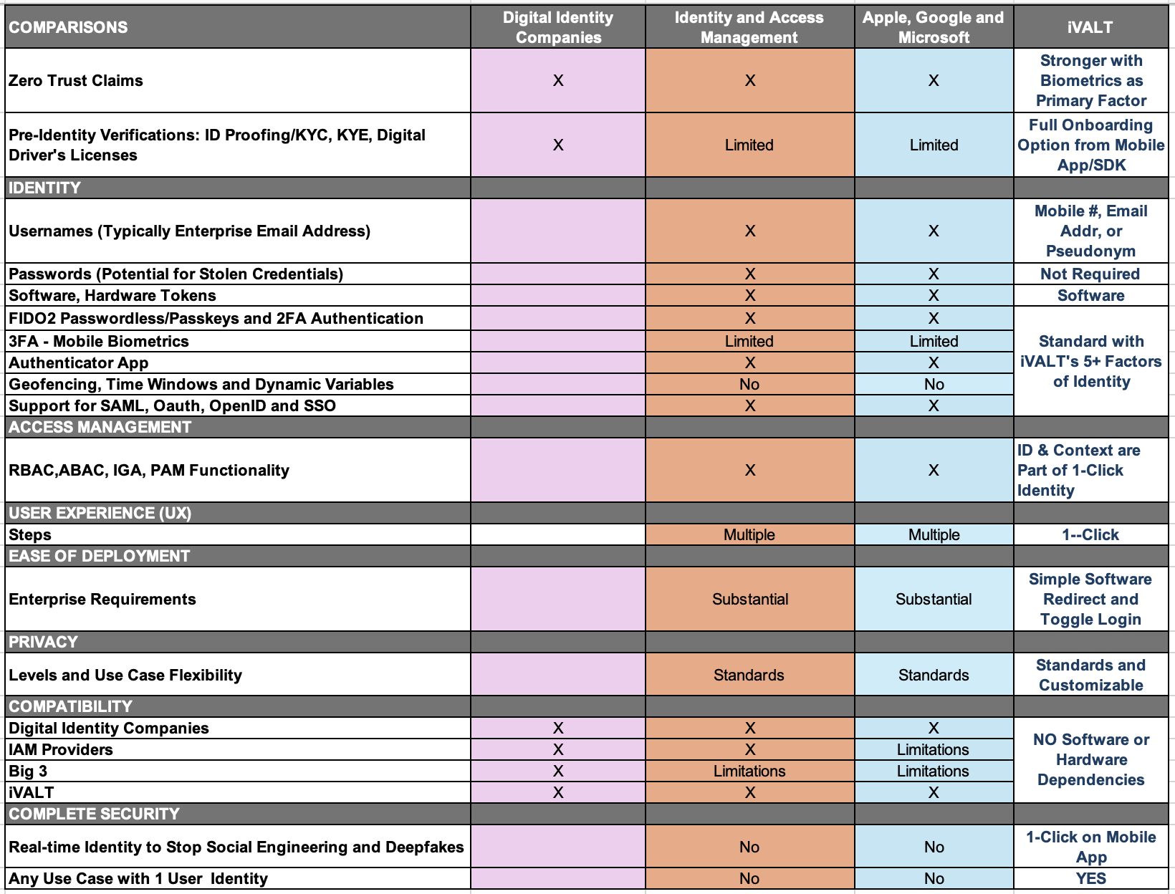
Competitive Comparisons
iVALT Differentiation
Unassailable Identity Stronger than Zero Trust
5+ Factors of Identity in 1-Click
Simplified
Enterprise IAM
Easy Implementation
User Defined Privacy
Backward Compatible
Stopping ID Hacking
Confidential ©2025 iVALT®

Slide 8
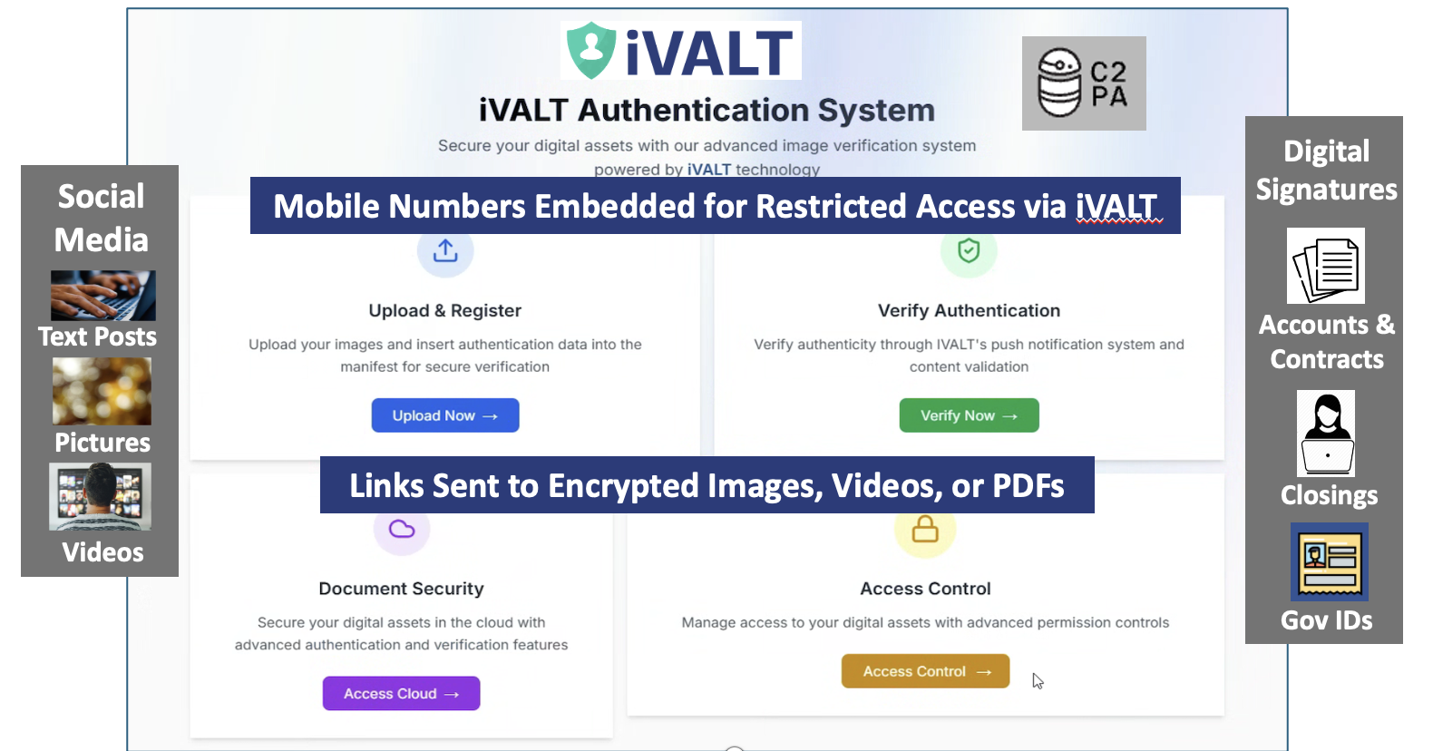
Document Protection
Restricted Access, Proof of Authorship and Authenticity
Confidential ©2025 iVALT®

Slide 9
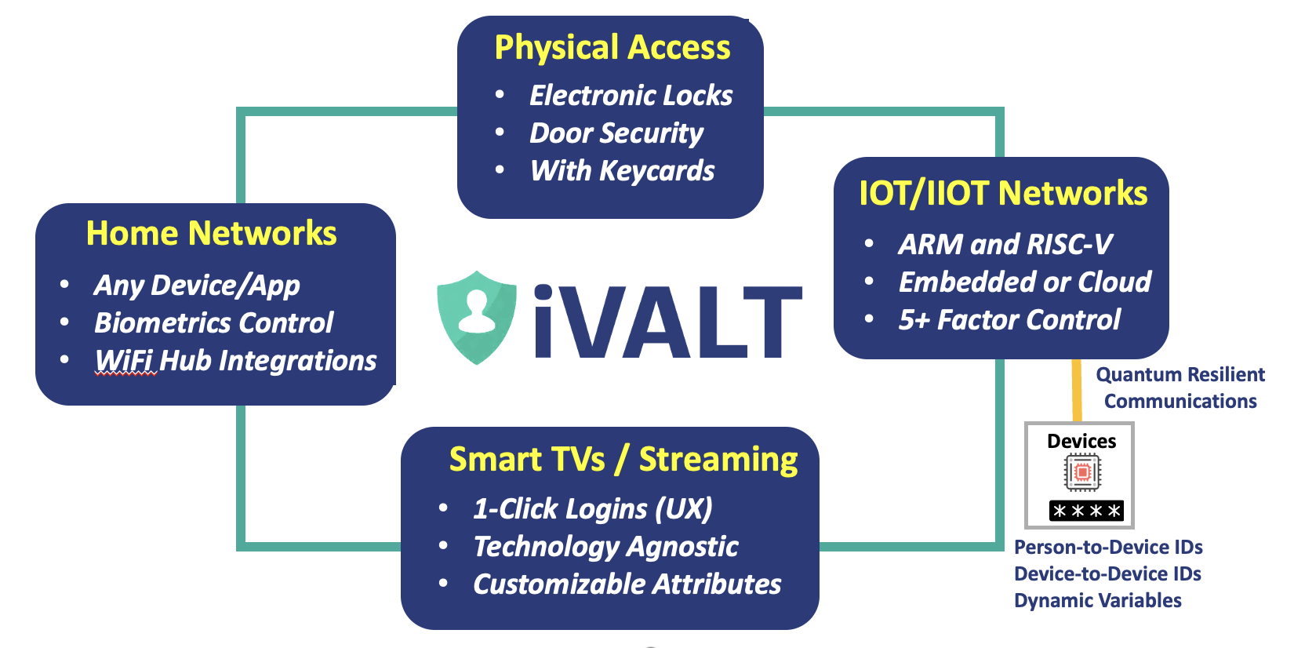
IOT Devices, Platforms & Networks
Confidential ©2025 iVALT®

Slide 10
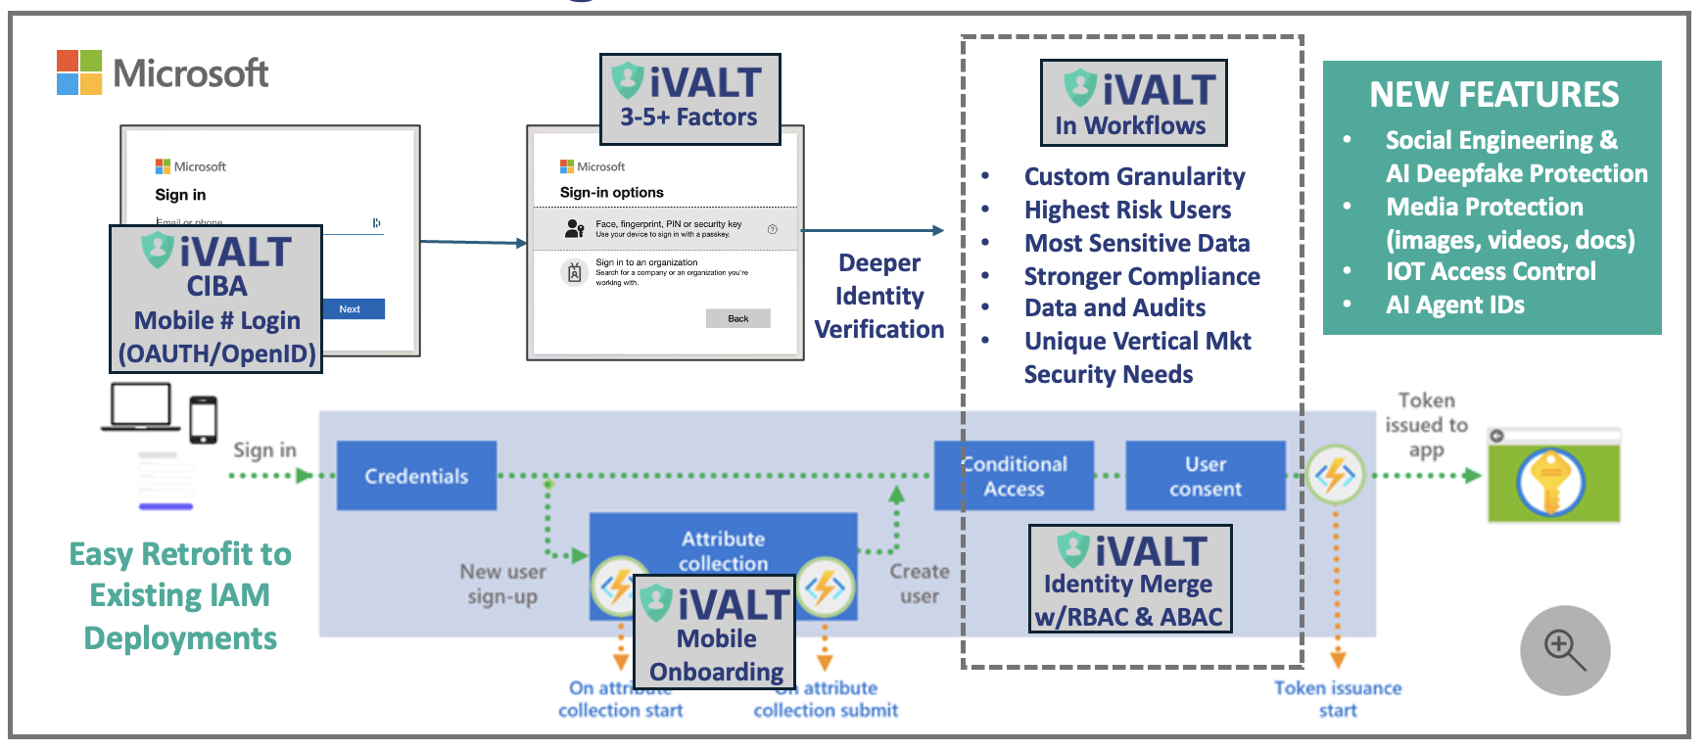
Enhancing MS Entra (Or Any IAM Platform)
Confidential ©2025 iVALT®

Slide 11
Intellectual Property
Mobile Biometrics/Connected Devices/Cloud Access
7 Patents Granted:
10+ Patents Filed and Pending:
Biometric Access for Streaming (10,931,667)
Device Identity for IoT (11,115,403)
Biometric Password Management (10,491,588)
Identity Release & Sharing between Devices (11,736,475)
Identity Verification in IOT Networks (12,028,335)
Method and System for User Authentication (Number TBD)
China: Use of Mobile Biometrics for Online Authentication ZL201980012921.0
Wide Variety of Use Cases w/AI
User Data Protection and Control
Streamlined User Experience
India – Biometrics for Online Auth
Trademarks:
Universal Biometric ID®
iVALT®
Authenticate Anywhere®
IDENTITY Validation Platform®
On-Demand ID™
1-Click to Zero Trust™
Confidential ©2025 iVALT®

Slide 12
Market Engagement
IOT & Document Protection
P3ID
Visioneer
Xerox
Major Hardware Provider
Verticals
Top 5 Systems Integrator
Identity Protection Firms
Major Lock Company
Healthcare Providers
Large Title Company
AI Workforce Optimization
IAM/SSO/CIBA
OKTA/Auth0
Ping Identity
Password Mgr (Master PW, SSO)
Psono
Quantum Resiliency
QuSecure
Wallets and Payments
Instarails (payments)
Fyntra (Crypto)
Major Credit Card Provider (P2P)
Confidential ©2025 iVALT®

Slide 13
Summary
Only Solution for Identity Fraud, Social Engineering, and AI Deepfakes – using a Single Mobile App
Only Solution for Critical Document Protection with Access Requiring 3-5+ Factors of Identity
Fully Compatible with Existing Systems (OAUTH or Simple Software Redirect for any Platform)
Confidential ©2025 iVALT®

Slide 14
Suggested Next Steps
Get Started with a POC (LOI)
On-Demand ID for Helpdesks as Suggested by Rajat
No Infrastructure Integrations
Mobile App Only
Work Out Tech and Business Stories for Clients
Broader Engagement Focused on a Specific Use Case
Secure Documents
CIBA for Enterprise IAM (Login with Mobile #)
IOT Device and/or AI Agent Identity
Confidential ©2025 iVALT®

Slide 15

Thank you!
Brian Stout
Co-Founder and CPO
brian@ivalt.com
+1 719.964.9650

Slide 16
Onboarding
Dashboard

